Slide 1
International Student & Scholar Services
What to Expect When Arriving in the U.S.
Summer 2025

Slide 2
Agenda
Introductions
Important Documents
What to expect on arrival
What if there is a problem?
How to Contact ISSS
Resources

Slide 3
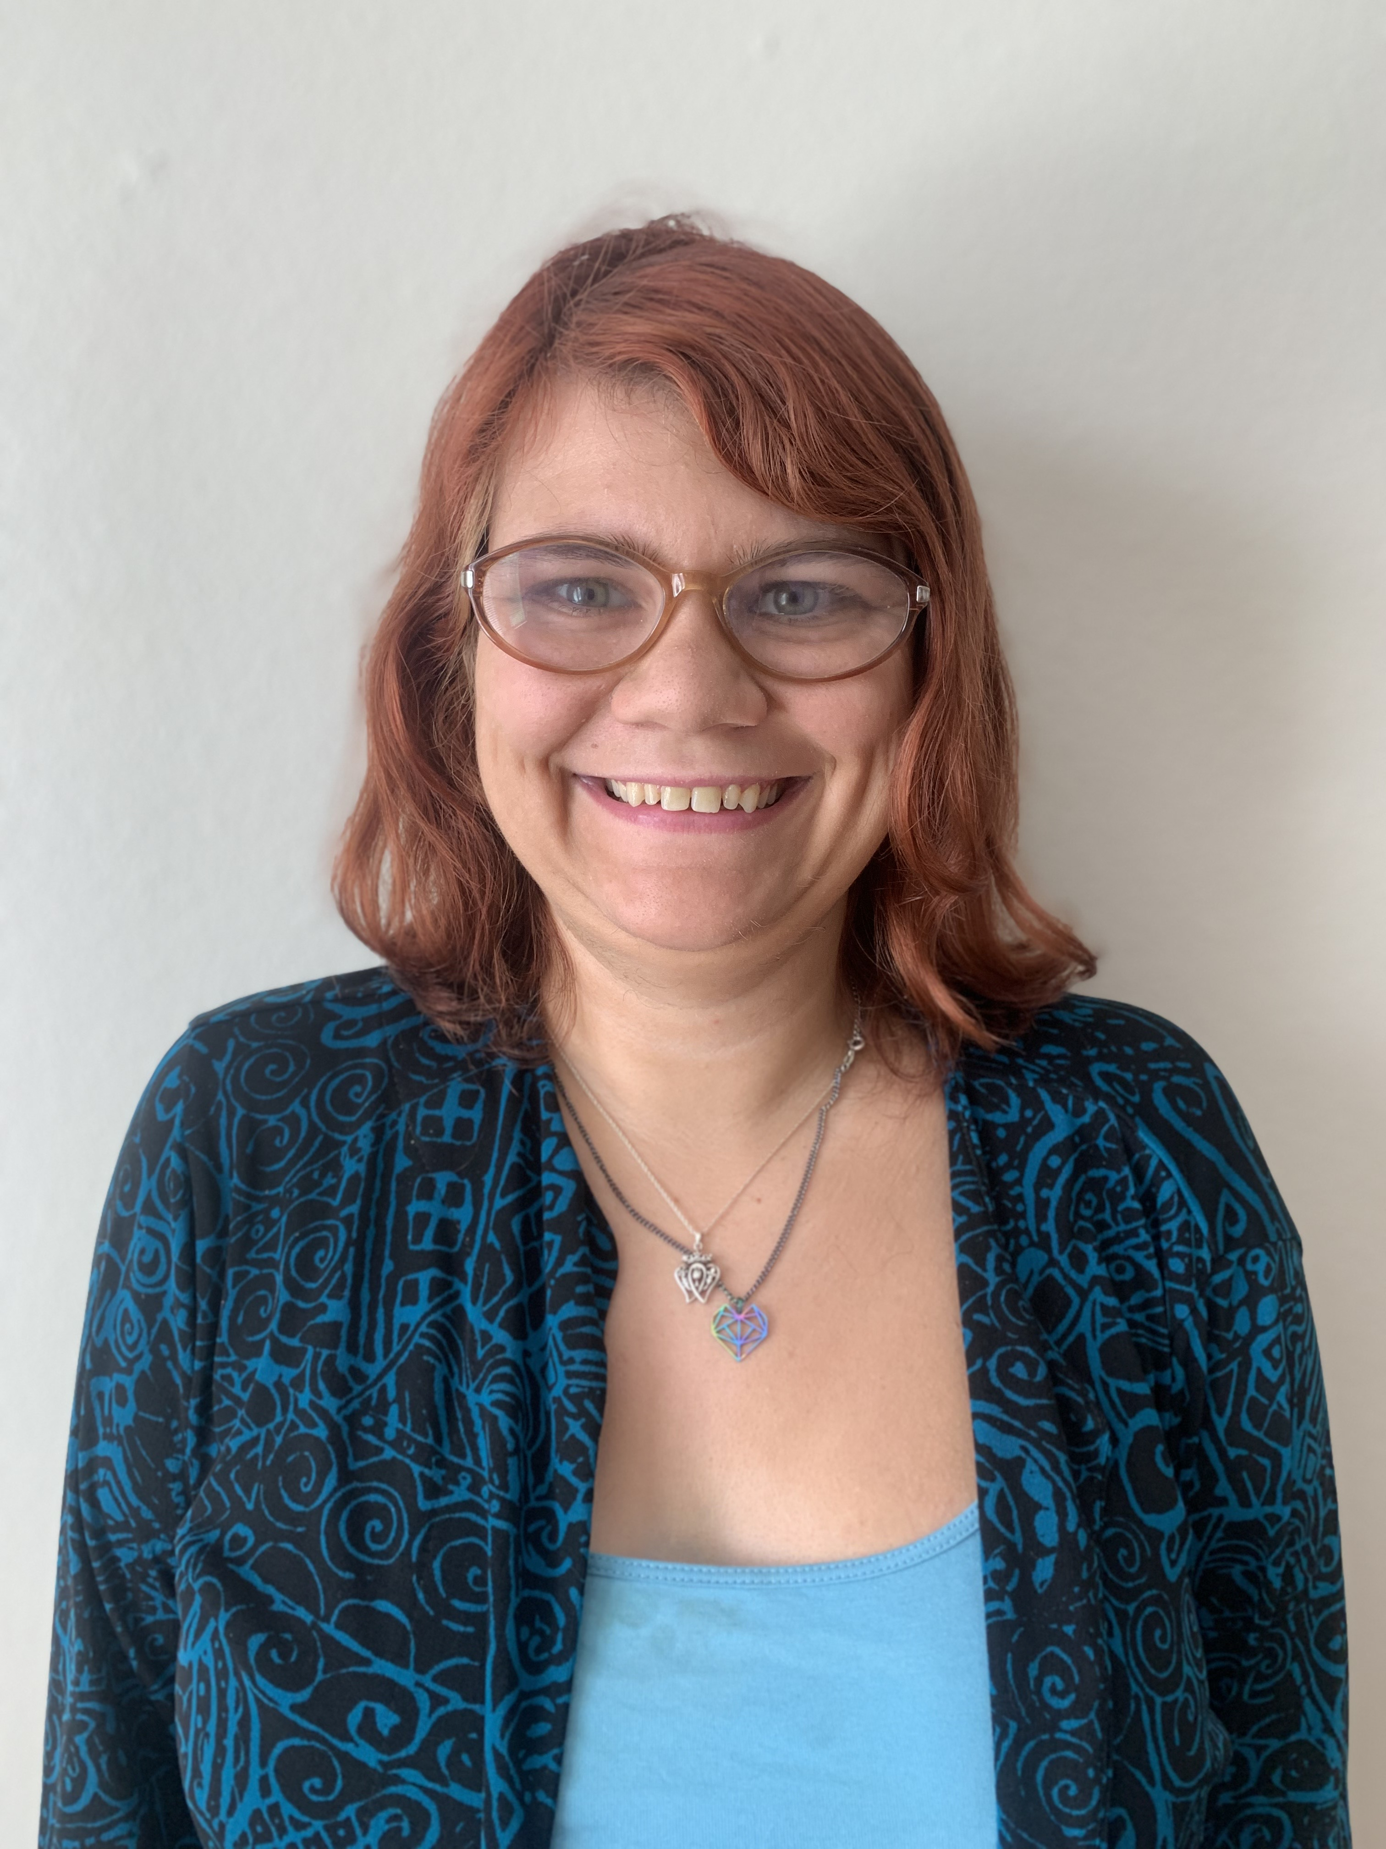


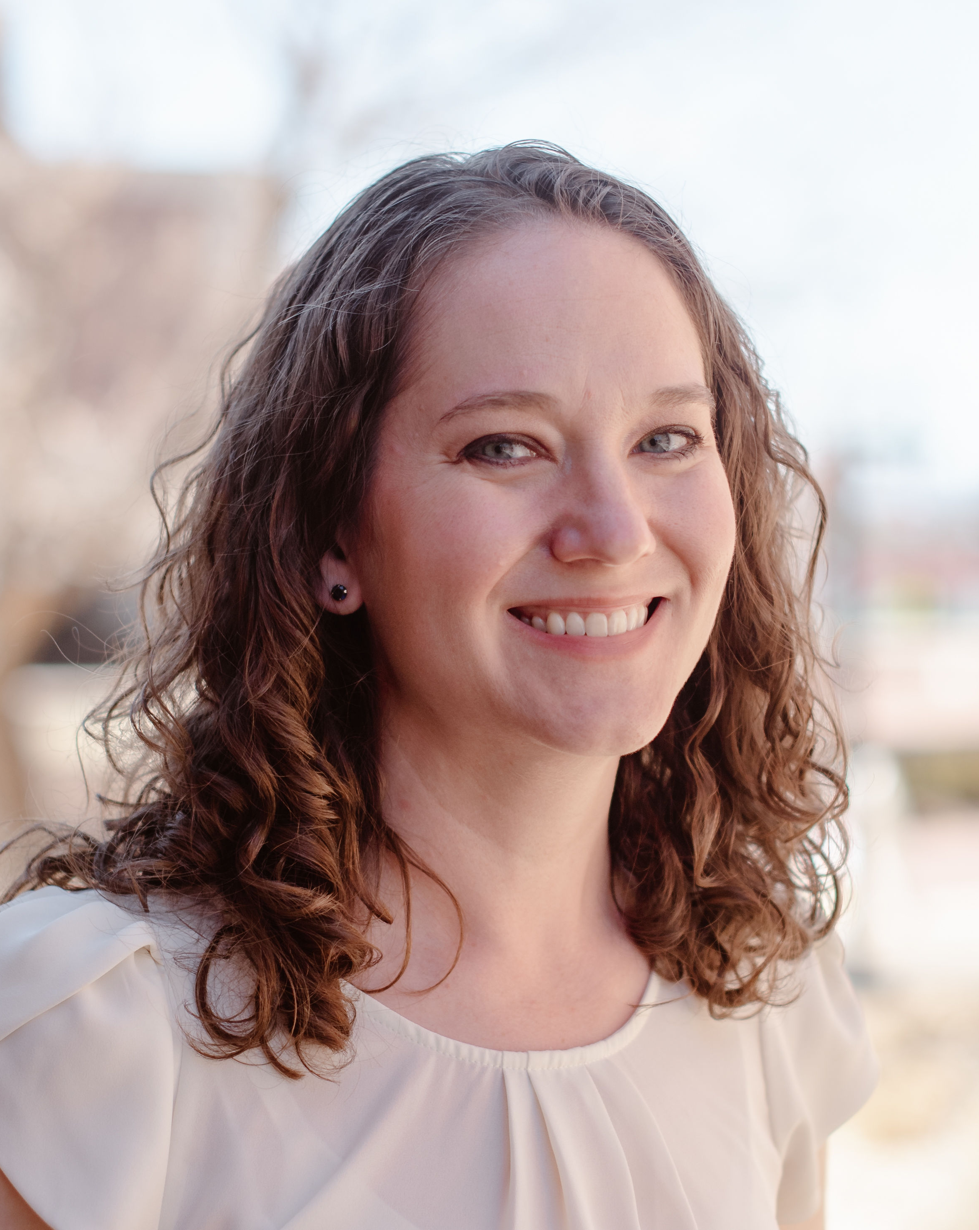
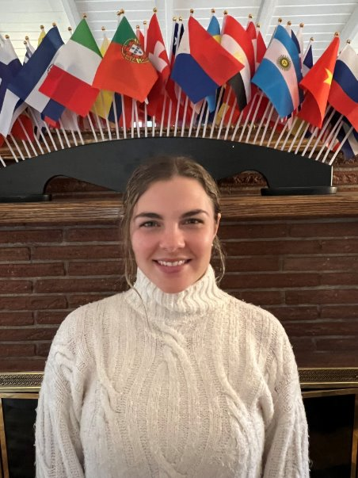
Introductions
Samantha Gerber​
SEVIS Coordinator & Advisor
Theresa Johnson
Director
Tom King
Senior International Student Advisor
Katie Pettet
Assistant Director
Emily Richards
International Student Advisor
Vacant
International Community & Programming Coordinator
We want to meet YOU! Please enter your name and which country you are coming from in the chat bar.

Slide 4
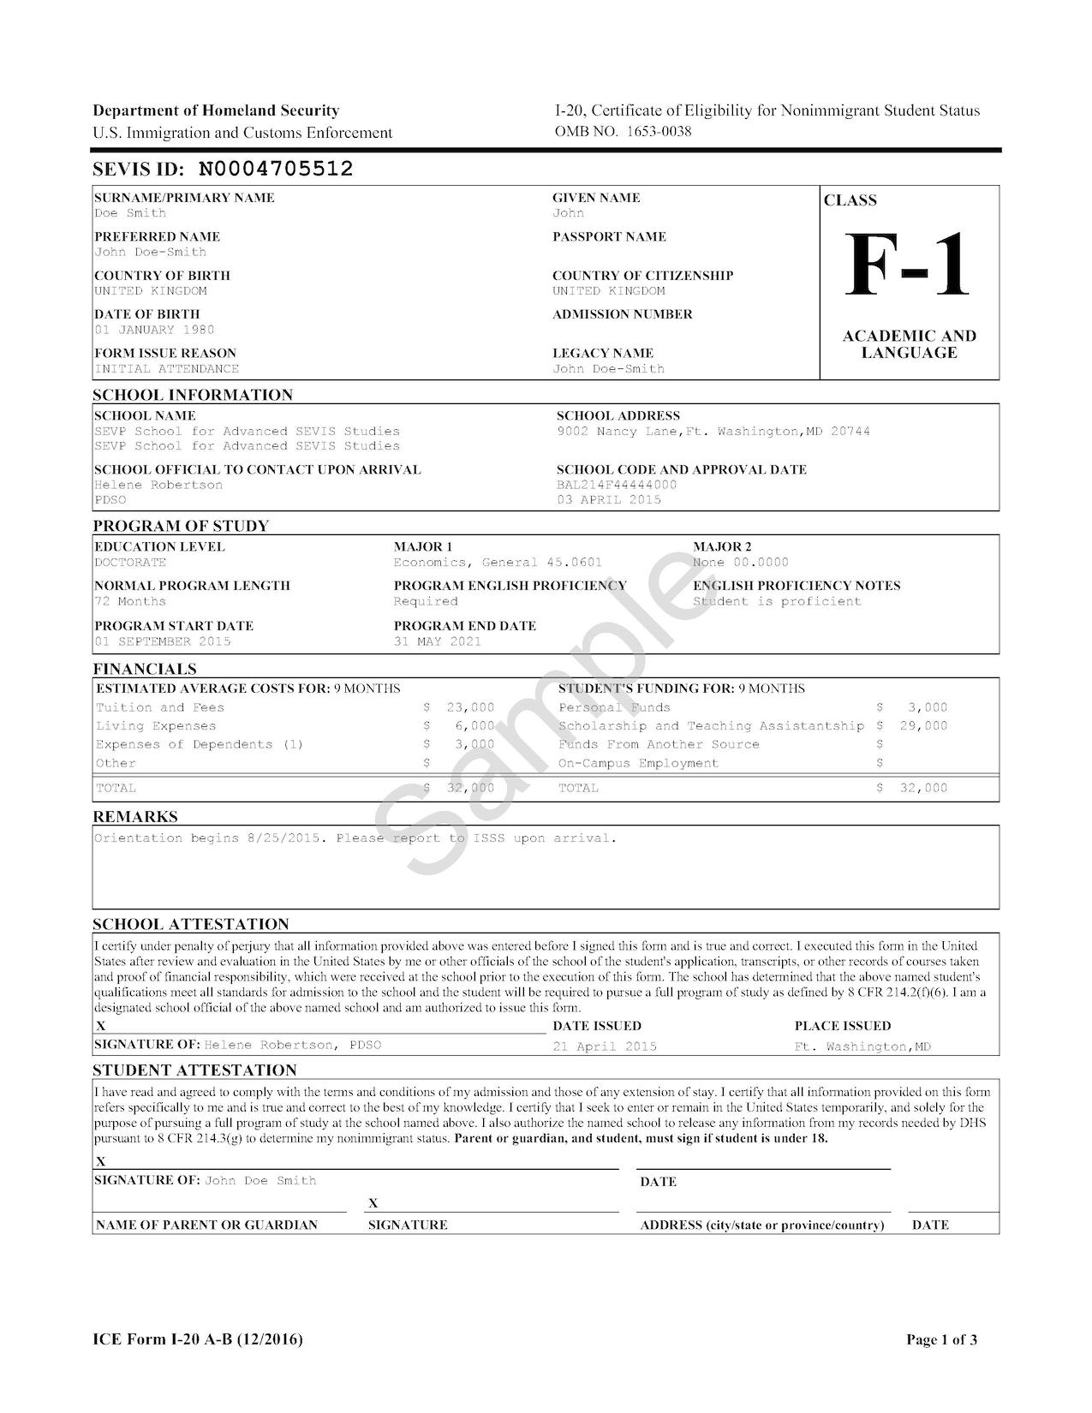
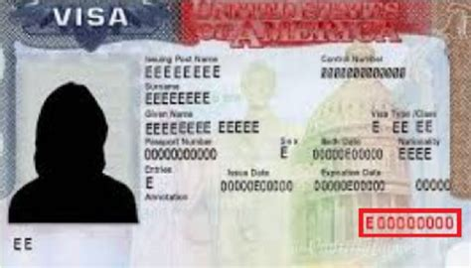
What F-1 documents to bring?
Pack all of these in your carryon luggage!
All F-1 Students
I-20 signed by you
Valid F-1 visa stamp
Passport valid for at least 6 months into the future
AND the relevant documents below
New F-1 students with an initial or transfer pending I-20
Letter of admission from University of Denver
Proof of funding
I-901 SEVIS fee receipt printout
Returning F-1 students with a continued attendance I-20
A travel signature on page 2 signed by ISSS within the last 12 months
Recommended: copies of your course transcripts and enrollment for the upcoming term
Returning F-1 students on OPT
A travel signature on page 2 signed within the last 6 months
EAD card
Recommended: proof of employment

Slide 5
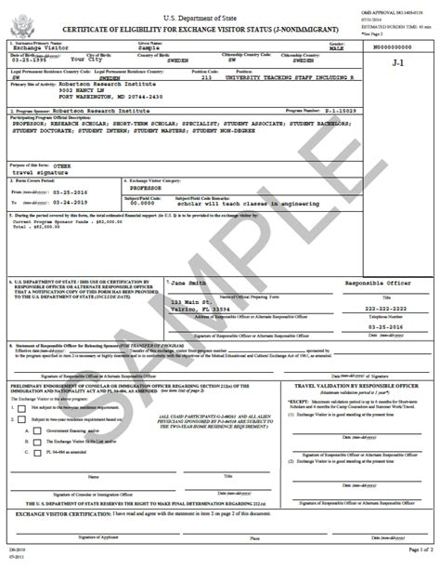

What J-1 documents to bring?
Pack all of these in your carryon luggage!
All J-1 Students
DS 2019 signed by you
Valid J-1 visa stamp
Passport valid for at least 6 months into the future
AND the relevant documents below
New J-1 students
Letter of admission from University of Denver
Proof of funding
I-901 SEVIS fee receipt printout
Returning J-1 students
A travel signature signed by ISSS within the last 12 months
Recommended: copies of your course transcripts and enrollment for the upcoming term
Returning J-1 students on Academic Training
A travel signature signed by ISSS within the last 12 months
Recommended: proof of employment

Slide 6
What to do on arrival?
Step 1: Immigration
When you arrive at your first port of entry (POE) in the U.S., you must go through immigration and customs.
TIP: Enter the U.S. through the Denver International Airport (if you can).
If you fly to the Denver International Airport, their website has maps and other helpful information.
When you get off the plane, follow the signs for “Non-U.S. Citizens.”
You might have to wait in a line.
Once you get to the front of the line:
Present your immigration documents (passport and I-20/DS-2019) to the officer.
Say that you are seeking F-1 or J-1 status as an international student at the University of Denver.
Answer any questions the officer asks accurately and honestly.
Show any other documentation as requested (financial documentation, etc.)
  This includes your cell phone, camera, computer, or other electronic device

Slide 7
What to do on arrival?
Step 1: Immigration cont’d
Some students are asked to go to “secondary inspection”
If this happens, don’t panic. It does not mean there is a problem or you are in trouble.
You will have to go through secondary inspection if the officer can’t immediately determine you are eligible to enter in F-1 or J-1 status.
This is very common for F-1 or J-1 students (especially if SEVIS is slow that day).
Once the officer determines you are eligible to enter the U.S. in F-1 or J-1 status, you can move on to step 2!
TIP: If you have access to a smart phone at the airport, check your electronic I-94 record of admission before you leave the immigration area!
Find your record on the CBP website
Check your record to ensure:
  your Class of Admission is F-1 or J-1
  you have been admitted for “Duration of Status” or “D/S”
If you can’t locate your I-94 record or if there is a problem (you are entered in B1/B2 status, for example) try to get it corrected before you leave the immigration area.

Slide 8
What to do on arrival
Step 2: Customs
After immigration, you will go to an area with the luggage carousel. Pick up your luggage and pass through Customs.
Do not bring any produce, food, or animal products with you to the U.S. Before you depart your home, review the list of restricted items here.
If you do bring a restricted item with you, you must declare it when going through customs. This is usually through a separate line so the officers can open and check your luggage.
If you bring over $10,000 (USD) in U.S. currency, foreign currency, traveler checks, money orders, etc., you must declare it to the Customs officials.
If you are unsure if you need to declare something, ask.

Slide 9
What to do on arrival
Step 3: Travel to your lodging – you made it!
Once you arrive in Denver, you will need to find transportation to your lodging. This can either be your permanent lodging – if you have already secured a place to stay – OR it can be temporary, such as a hotel.
When you arrive at the airport, you can get around Denver in several ways:
the “RTD” system (the public transportation system)
a shared van service
Private taxi/Uber/Lyft
Before you depart your home, be sure that you know where you will stay when you arrive in Denver! DU does not provide temporary housing. Although DU doesn’t offer temporary housing, we do have partnerships with local hotels for discounted rates. A list of these hotels is available on the Community and Visitors page of the DU website

Slide 10
What if I am not granted entry?
If you have all of your immigration documents, you should encounter no trouble entering the U.S. in F-1 or J-1 status.
If you experience unexpected problems when trying to enter the U.S. such as being denied boarding for an international flight to the U.S. or denied entry into the U.S. while in possession of all necessary immigration documents (listed above), please contact Campus Safety (1-303-871-2334 or Toll Free at 1-800-268-6594).

Slide 11
How to Contact ISSS
Email isss@du.edu
Schedule a Zoom Advising Appointment

Slide 12

Tips for Emailing ISSS
Include your DU ID# (87#)
Send to isss@du.edu, not to advisor
Do not send to multiple advisors
Responses to email take 1-3 business days
Check your DU email regularly

Slide 13


https://internationalization.du.edu/isss
Ways to Connect with ISSS
isss@du.edu
Instagram @isss_du

Slide 14
Resources
Denver International Airport: https://www.flydenver.com/international-travelers/
CBP list of restricted items and what to declare: https://www.cbp.gov/travel/us-citizens/know-before-you-go/prohibited-and-restricted-items
Information on Clearing Customs: https://www.cbp.gov/travel/clearing-customs
Information for Admission into the U.S.: https://www.cbp.gov/travel/international-visitors/applying-admission-united-states
ACLU Know Your Rights at the Border: https://www.aclu.org/know-your-rights/what-do-when-encountering-law-enforcement-airports-and-other-ports-entry-us
ISSS Travel Website: https://internationalization.du.edu/isss/current-students/travel
ISSS Immigration Update Website: https://internationalization.du.edu/isss/content/immigration-updates

Slide 15
International Student & Scholar Services

